Slide 1
Predicting Energy Prices for Procurement using Machine Learning
Kibreab
Essen 01.08.2023

Slide 2
Introduction to Coal Shipment Data
Why Coal ?
U.S. Energy Information Administration (EIA), API
The data includes attributes like ash content, heat content, price, quantity, and sulphur content

Slide 3
Data
['period', 'location', 'plant State Description', 'plant', 'plant Name', 'rank', 'coalRankDescription', 'ash-content', 'heat-content', 'price', 'quantity', 'sulfur-content', 'ash-content-units', 'heat-content-units', 'price-units', 'quantity-units', 'sulfur-content-units’]
period location ... quantity-units sulfur-content-units
0 2022 NM ... tons percent by weight
1 2022 WY ... tons percent by weight
2 2022 PAB ... tons percent by weight
3 2022 OH ... tons percent by weight
4 2022 NM ... tons percent by weight...

Slide 4
Data Preprocessing
ensure data quality, we removed missing values and converted non-numeric prices to numeric
selected relevant features such as ash content, heat content, quantity, and location
scaled the numerical features to a range of [0, 1] using Min-Max scaling.

Slide 5
Machine Learning Models
Two machine learning models:
Random Forest Regressor and
Linear Regression.
We trained both models on the training data and evaluated their performance on test data.

Slide 6
Model Evaluation
 | MSE | training data | the test data
Random Forest | 0.0013 | 0.9473 | 0.6165
Linear Regression | 0.0032 | 0.0693 | 0.0795
R-squared- goodness-of-fit Mean Squared Error- evaluate prediction accuracy MSE suggests that the model's predictions deviation from the actual values

Slide 7
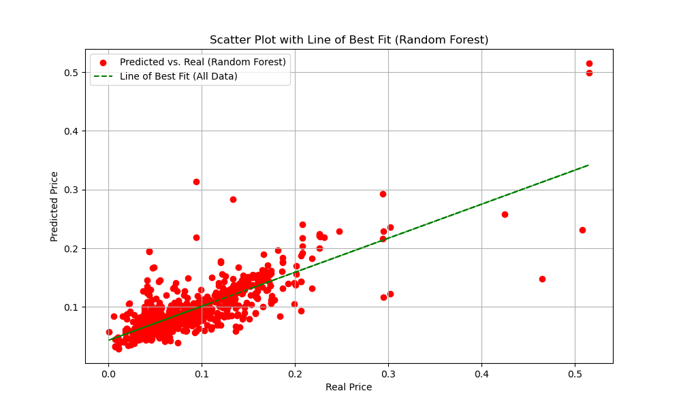
Data Visualization

Slide 8
Conclusion
In conclusion, our analysis provides insights into coal shipments using machine learning models for operations.
The results can assist in energy production and supply chain management decision-making, such as transportation, storage, and green certificate optimization in the feature
Strategic needs specific using convex SC-logistics optimising using CVXpy

